Slide 1
Scope of today’s work
I have to tell you about why enthalpy was invented
The 2nd Law of Thermodynamics

Slide 2

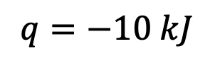
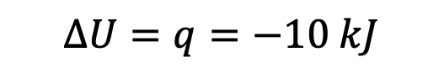
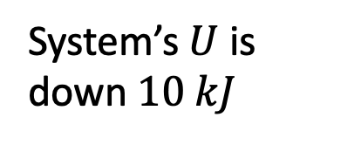
Why enthalpy was invented
The 1st Law says $∆U=q+w$. Here’s a nice thing about that: when there’s no PV work done (no expansion or contraction), $∆U=q$. That means …
System undergoes an exothermic reaction
System’s $U$ is down $10 kJ$
$$q=−10 kJ$$
$$∆U=q=−10 kJ$$

Slide 3


Why enthalpy was invented
The 1st Law says $∆U=q+w$. Here’s a nice thing about that: when there’s no PV work done (no expansion or contraction), $∆U=q$. That means …
System undergoes an exothermic reaction
System’s $U$ is down $10 kJ$
$$q=−10 kJ$$
$$∆U=q=−10 kJ$$
But what if it can expand?
System undergoes an exothermic reaction
$$q=−10 kJ$$
$$∆U≠q$$

Slide 4
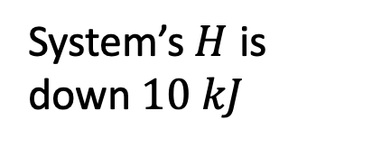

Why enthalpy was invented
The 1st Law says $∆U=q+w$. Here’s a nice thing about that: when there’s no PV work done (no expansion or contraction), $∆U=q$. That means …
System undergoes an exothermic reaction
System’s $U$ is down $10 kJ$
$$q=−10 kJ$$
$$∆U=q=−10 kJ$$
But what if it can expand? For constant-pressure processes, it turns out that …
System undergoes an exothermic reaction
System’s $H$ is down $10 kJ$
$$q=−10 kJ$$
$$∆H=q$$

Slide 5

Why enthalpy was invented
The 1st Law says $∆U=q+w$. Here’s a nice thing about that: when there’s no PV work done (no expansion or contraction), $∆U=q$. That means …
System undergoes an exothermic reaction
System’s $U$ is down $10 kJ$
$$q=−10 kJ$$
$$∆U=q=−10 kJ$$
But what if it can expand? For constant-pressure processes, it turns out that …
System undergoes an exothermic reaction
System’s $H$ is down $10 kJ$
$$q=−10 kJ$$
$$∆H=−10 kJ$$

Slide 6
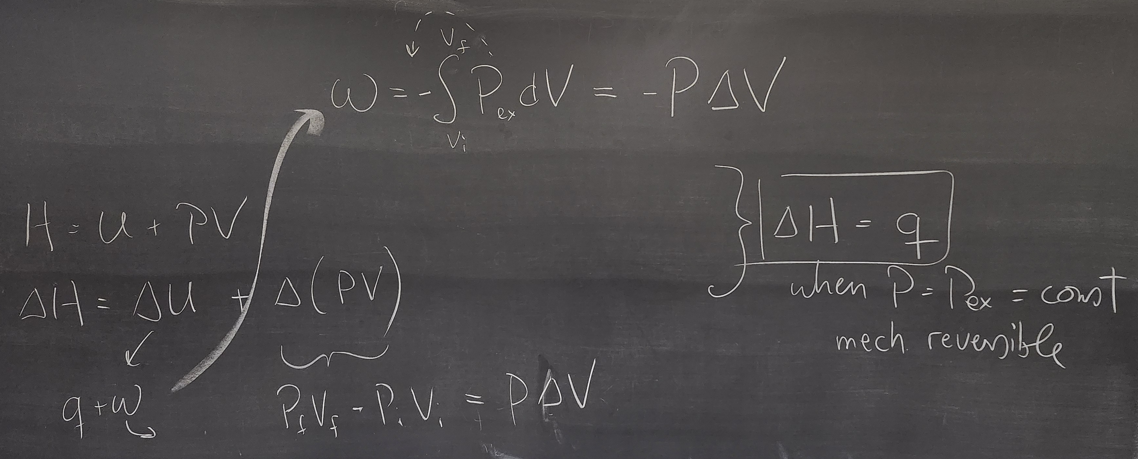
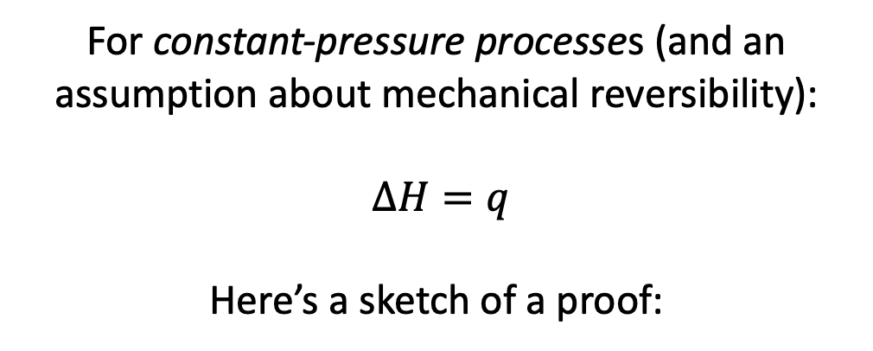
Why enthalpy was invented
For constant-pressure processes (and an assumption about mechanical reversibility):
$∆H=q$
Here’s a sketch of a proof:

Slide 7
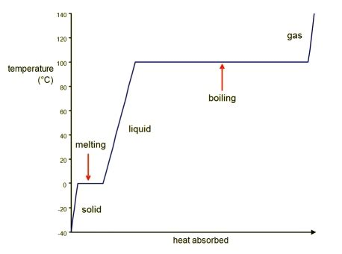
Physical context for what we’re talking about today
gas
gas
solid
solid
liquid
liquid

Slide 8
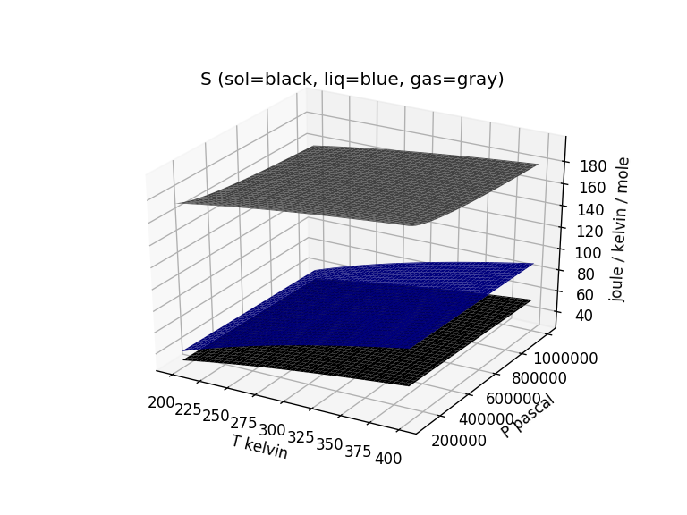


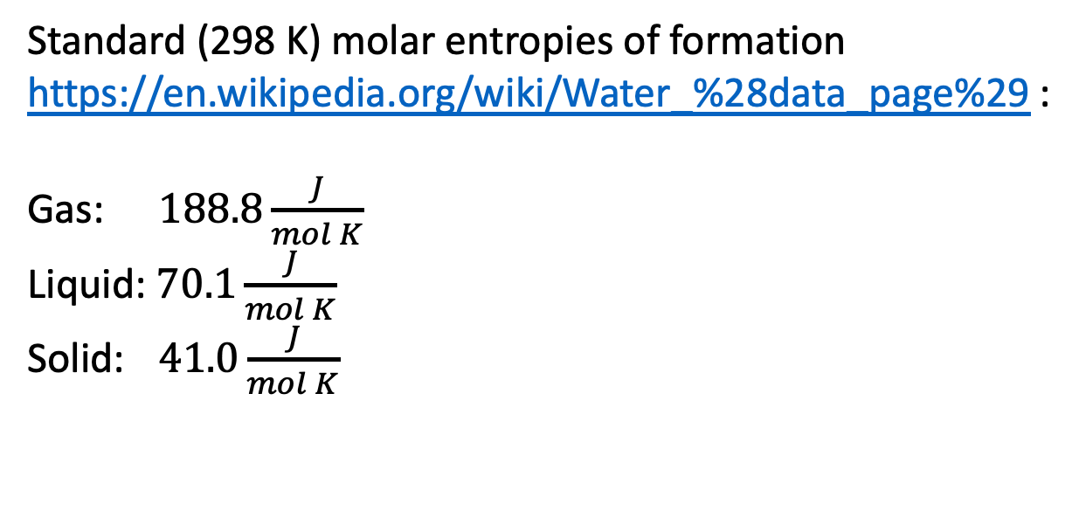

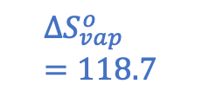

Entropy change of the system: $∆S_{vap}$ at the standard-state temperature (298 K)
Standard (298 K) molar entropies of formation https://en.wikipedia.org/wiki/Water_%28data_page%29 :
Gas: $188.8\frac{J}{mol K}$
Liquid: $70.1\frac{J}{mol K}$
Solid: $41.0\frac{J}{mol K}$
$$188.8$$
$${∆S}_{vap}^{o}=118.7$$
$$∆S_{vap}^{o}=118.7 \frac{J}{mol K}$$
$$70.1$$
$$41.0$$

Slide 9
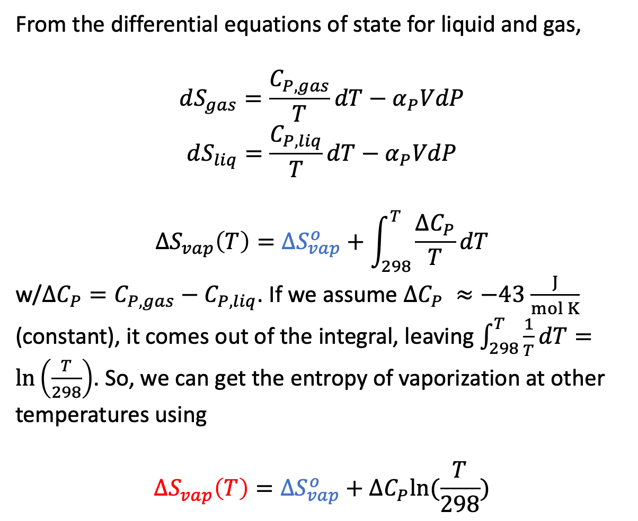
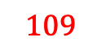
Entropy change of the system: $∆S_{vap}$ at other temperatures
From the differential equations of state for liquid and gas,
$$dS_{gas}=\frac{C_{P,gas}}{T}dT−α_{P}VdP$$
$$dS_{liq}=\frac{C_{P,liq}}{T}dT−α_{P}VdP$$
$${∆S}_{vap}\left(T\right)={∆S}_{vap}^{o}+\int_{298}^{T}{\frac{∆C_{P}}{T}dT}$$
w/$∆C_{P}=C_{P,gas}−C_{P,liq}$. If we assume $∆C_{P} ≈−43$ $\frac{J}{mol K}$ (constant), it comes out of the integral, leaving $\int_{298}^{T}{\frac{1}{T}dT}=\ln\left(\frac{T}{298}\right)$. So, we can get the entropy of vaporization at other temperatures using
$${∆S}_{vap}\left(T\right)={∆S}_{vap}^{o}+∆C_{P}ln⁡(\frac{T}{298})$$
$${∆S}_{vap}^{o}=118.7$$
$$109$$

Slide 10
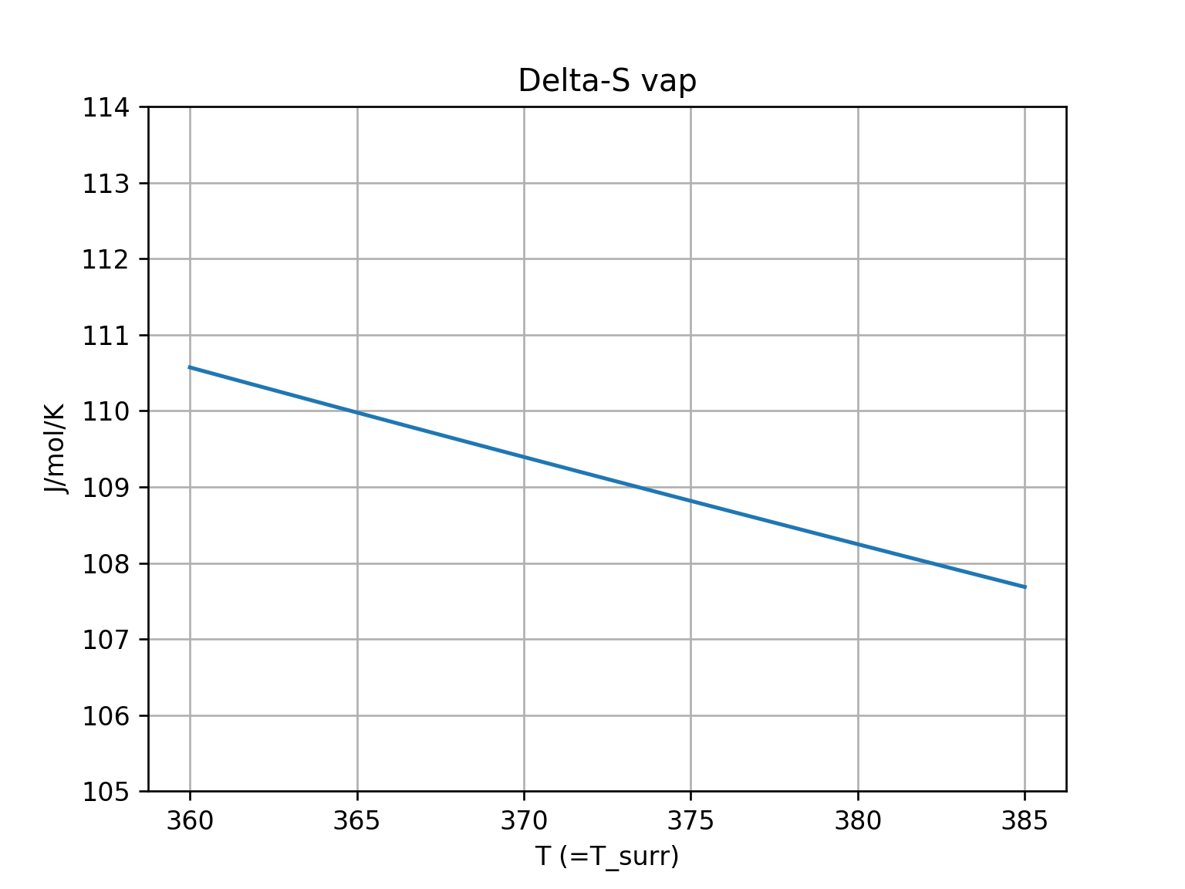
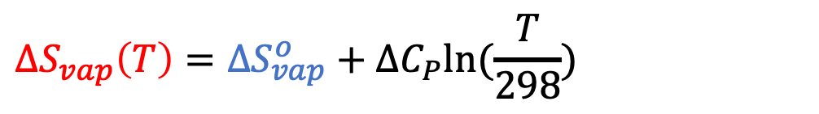
Entropy change of the system: $∆S_{vap}$ at other temperatures
$${∆S}_{vap}\left(T\right)={∆S}_{vap}^{o}+∆C_{P}ln⁡(\frac{T}{298})$$
$${∆S}_{vap}^{o}=118.7$$
$$109$$
slopes down

Slide 11
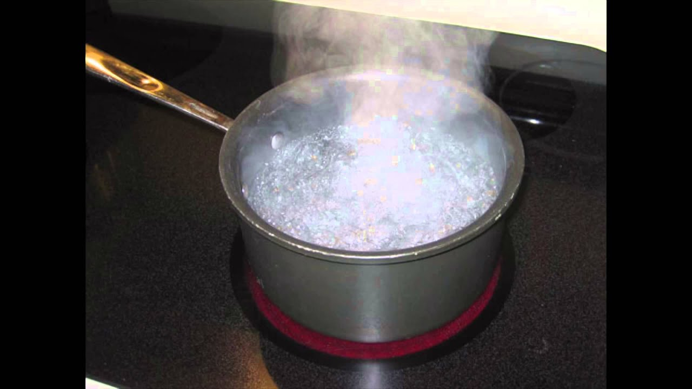
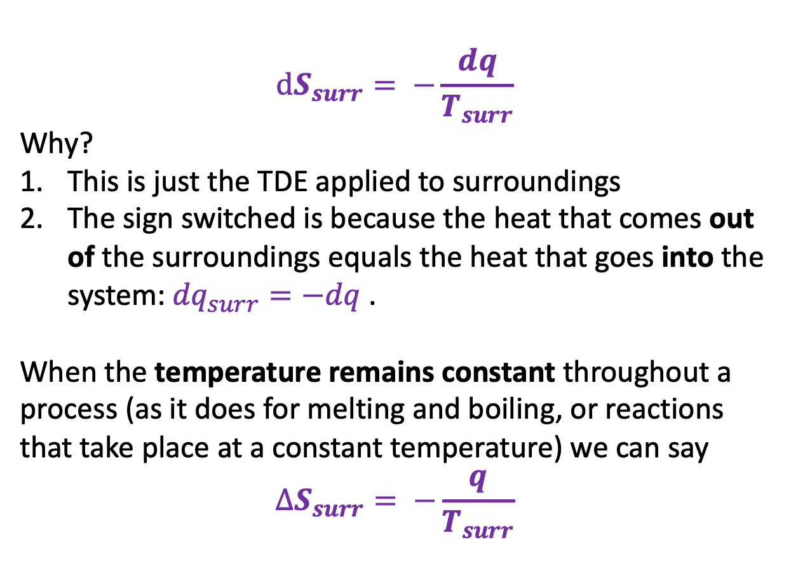
Entropy change of the surroundings: $∆S_{surr}$
$$dS_{surr}= −\frac{dq}{T_{surr}}$$
Why?
This is just the TDE applied to surroundings
The sign switched is because the heat that comes out of the surroundings equals the heat that goes into the system: ${dq}_{surr}=−dq$.
When the temperature remains constant throughout a process (as it does for melting and boiling, or reactions that take place at a constant temperature) we can say
$$∆S_{surr}= −\frac{q}{T_{surr}}$$
We can take this one step farther, knowing that $q=∆H$ for a constant-pressure process, we can say $∆S_{surr}= −\frac{∆H}{T_{surr}}$.

Slide 12
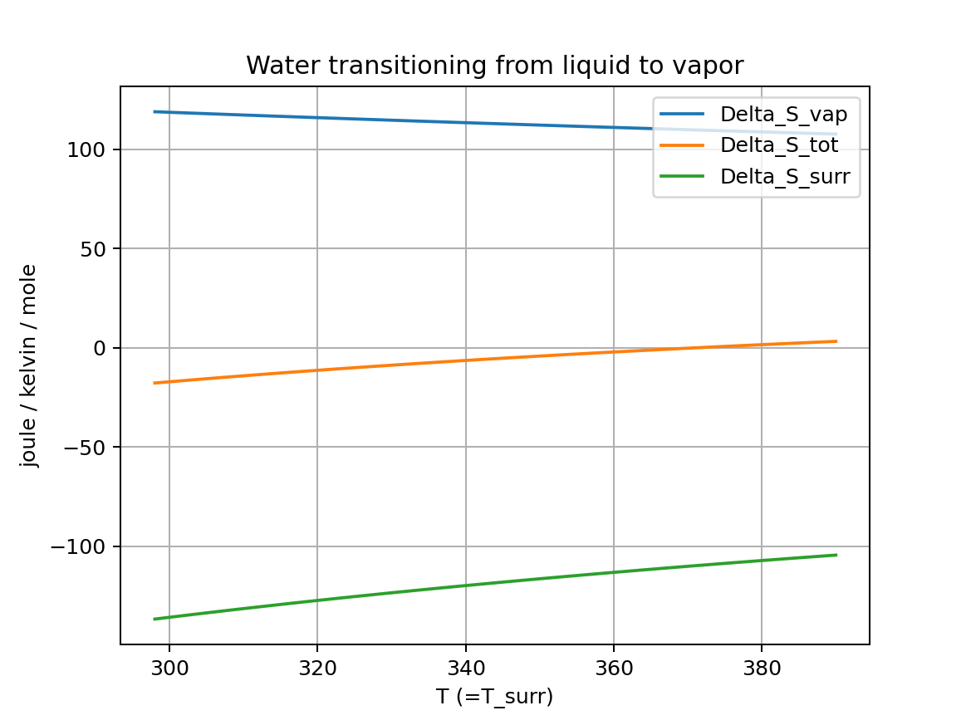
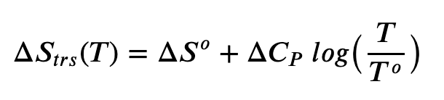
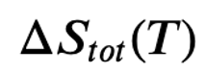
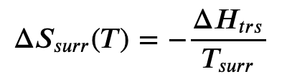
Putting these on the same scale and insisting on thermal equilibrium (so $T=T_{surr}$) …

Slide 13
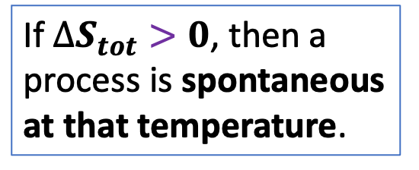
Introducing the 2nd Law of Thermodynamics:
If $∆S_{tot}>0$, then a process is spontaneous at that temperature.

Slide 14
Introducing the 2nd Law of Thermodynamics:
If $∆S_{tot}>0$, then a process is spontaneous at that temperature.

Slide 15
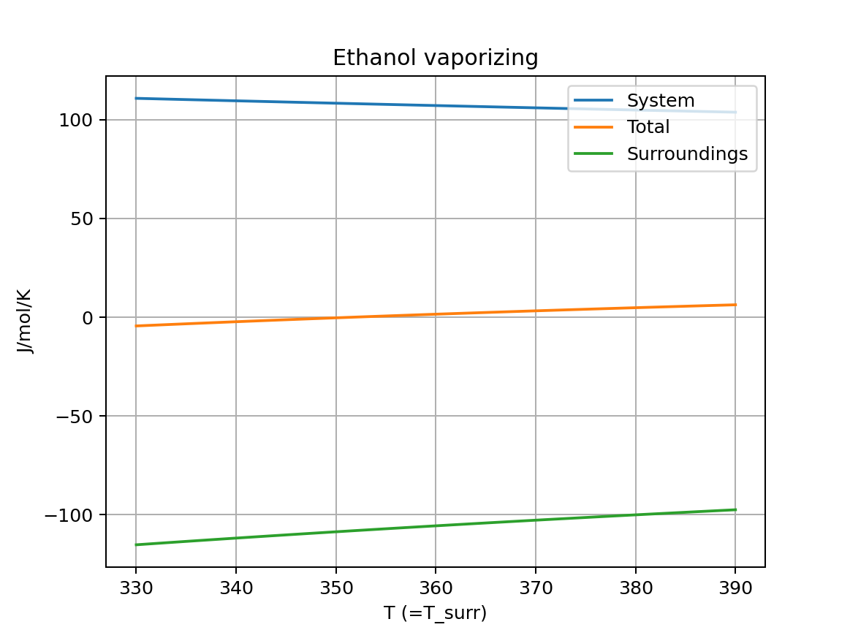
We can do this for other substances – like EtOH

Slide 16
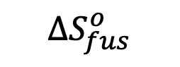
We can do this for melting too
$${∆S}_{fus}^{o}$$

Slide 17
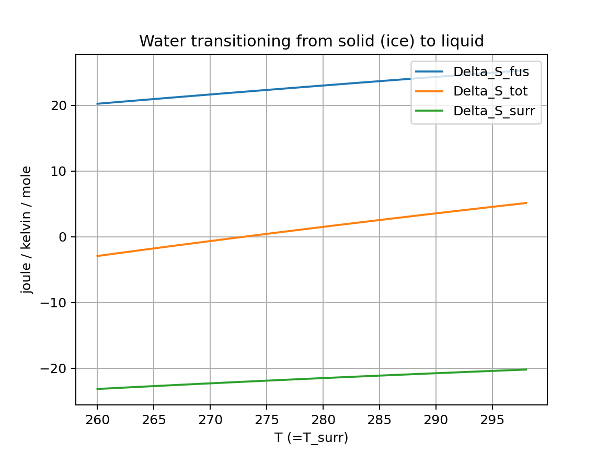
We can do this for melting too

Slide 18
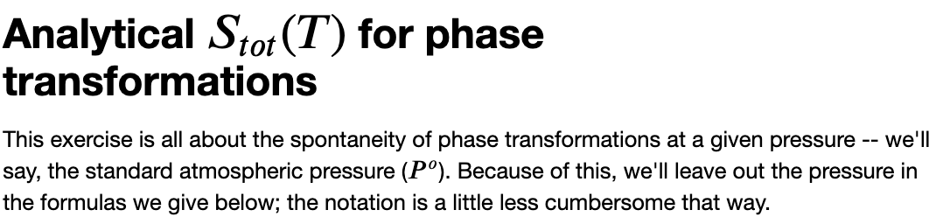
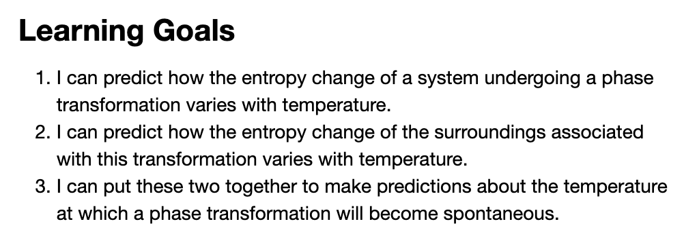
OK, let’s get started

